Slide 1
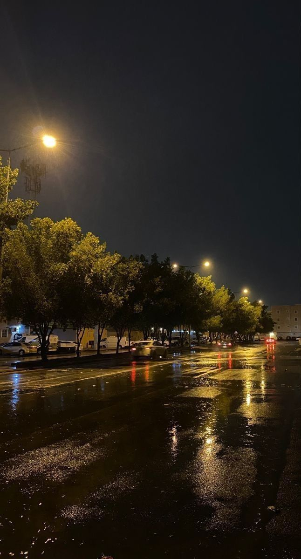
Intelligent Street Light System
Team Mates:
Guide: Veera Reddy
Assistant Professor
CSE(AI & ML)
Akshitha Jain - | 22UP1A6601
G. Srinidhi - | 22UP1A6617
K. Varshitha - | 22UP1A6628
M. Srinidhi - | 22UP1A6644

Slide 2

ABSTRACT
In the age of smart technology, energy consumption and automation are essential components of a sustainable smart city. This project intelligent street light system utilizes IoT concepts to optimize energy use by automatically adjusting LED brightness based on ambient light level detected by the LDR sensor. This is built with an Arduino microcontroller, LDR (Light Dependent Resistor) sensor, and LEDs. The system automatically adjusts the brightness of the street lights based on the ambient light levels detected by the LDR sensor. When natural light is low, the LEDs glow brighter, and when there is sufficient daylight, the intensity reduces, thereby conserving energy and also improving visibility.

Slide 3
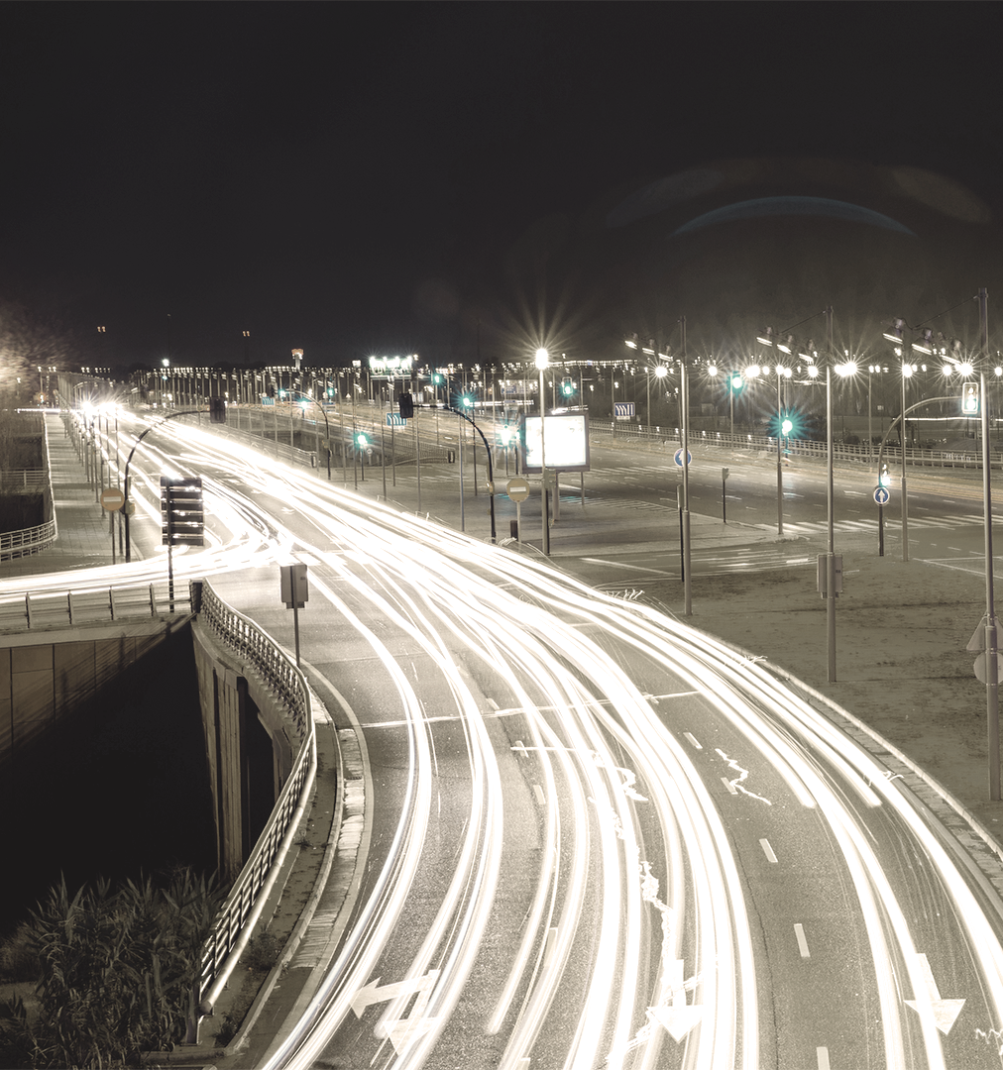
INTRODUCTION
Street lights are essential for safety and visibility.
Traditional systems waste energy due to fixed timing.
Seasonal and weather changes affect lighting needs.
Need for smarter, adaptive solutions.

Slide 4
LITERATURE SURVEY
S.NO | Titles | Authors | Methodology | Drawback
1 | SMART STREET LIGHTING Using IoT | Sakshi Dhoke, Sharda Jadhav, Mayuri Jasturkar. | Proposed a motion-based street lighting system that activates lights when movement is detected. | Does not consider weather conditions like fog or rain.
2 | Advanced Solar Power LED Street Lighting | Abubakar Mukhtar, Mr. Rakesh Kumar | Developed a solar-powered LED streetlight system for energy efficiency. | Lacks intelligent adaptive control for varying light conditions.
3 | . Smart Street Lighting System Using IoT for Sustainable Urban Development | P. Sharma, D. R. Kalbande | The system utilizes PIR sensors to detect motion, enabling dynamic control of streetlights. | Lacks intensity of light variations.

Slide 5
S.NO | Title | Authors | Methodology | Drawback
4 | IoT-Based Smart Street Light System | Sakshi Dhoke1, Sharda Jadhav, Mayuri Jasturkar | It discusses the integration of sensors and microcontrollers to automate street lighting, aiming to reduce energy consumption and enhance efficiency. | Does not consider changing the intensity of light.
5 | Smart Street Light Control System Using Arduino | Mahendra Singh Sisodiya, Tarun Shrivastava, Ashish Patra | street lights ON when motion is detected and OFF when no motion is detected, using IR sensors and Arduino. | Lacks intelligent adaptive control for varying light conditions.

Slide 6
Existing System
The current streetlight systems operate on fixed schedules or simple motion-based mechanisms.
These systems either turn on/off at specific times or rely on PIR sensors to detect movement.
Some advanced setups use solar-powered LEDs, but they lack intelligent control based on environmental factors.

Slide 7
Disadvantages- Existing System
High Energy Wastage
Ineffective During Weather Conditions
Higher Operational Costs

Slide 8
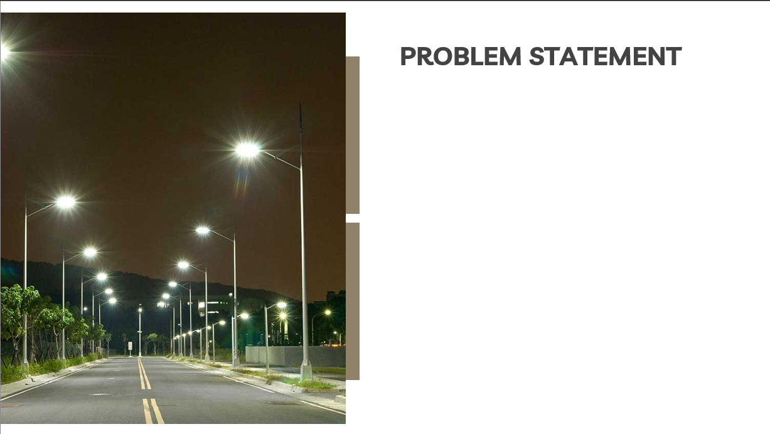
Traditional street lights operate on fixed schedules and lack adaptability to changing weather and daylight conditions. This leads to energy waste—lights stay ON, it may turn on too late during dark, cloudy, or winter evenings. An automated system is needed to adjust lighting based on real-time ambient light for better efficiency and safety.

Slide 9
Proposed System
Uses an LDR sensor to detect surrounding light levels and adjust LED brightness automatically.
Arduino Uno processes sensor data and controls the LED intensity
Street lights dim or brighten based on ambient light conditions (e.g., brighter at night, dimmer at dawn/dusk).
Responds to seasonal variations, such as earlier darkness in winter or cloudy days.
Aims to provide energy-efficient, automated, and cost-effective street lighting.

Slide 10
Hardware and Software Requirements
Hardware Requirements
Arduino Uno – Acts as the microcontroller to process sensor data and control LED brightness.
LDR Sensor – Detects ambient light levels to decide brightness adjustments.
LEDs (Light Emitting Diodes) – Used as street lights with brightness controlled.
Power Supply –USB power for the Arduino and components.
Software Requirements
Arduino IDE – Used to write, compile, and upload code to the Arduino board.
Embedded C++ – A programming language for writing microcontroller logic.

Slide 11
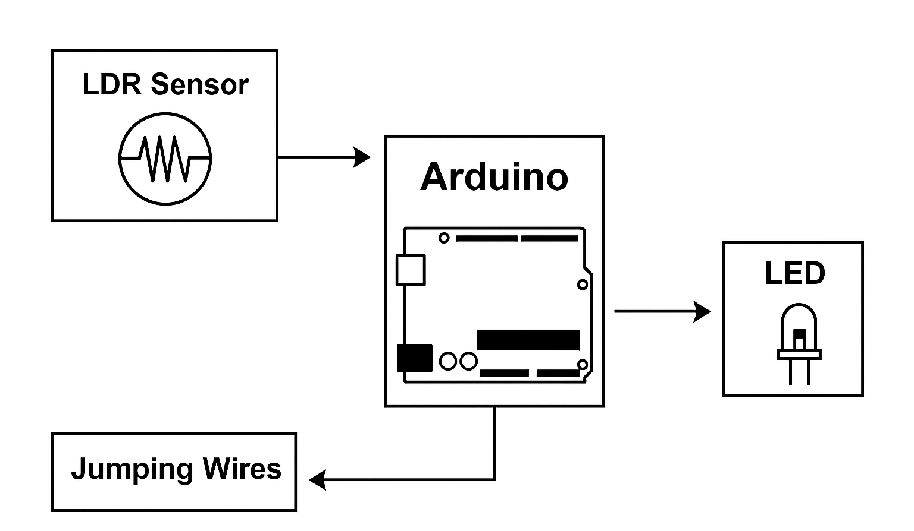
System Architecture

Slide 12
Methodology
Sensor Input: The LDR sensor detects ambient light, and the DHT11 sensor measures temperature and humidity.
Data Processing: The Arduino Uno collects sensor data and processes it using a programmed logic.
Light Intensity Control: Based on the sensor readings, the Arduino adjusts the brightness of the LED.
Real-Time Adjustment: The system continuously monitors the environment and dynamically changes the light intensity.
Energy Efficiency: By avoiding unnecessary lighting and adjusting brightness as needed, the system reduces power consumption.

Slide 13
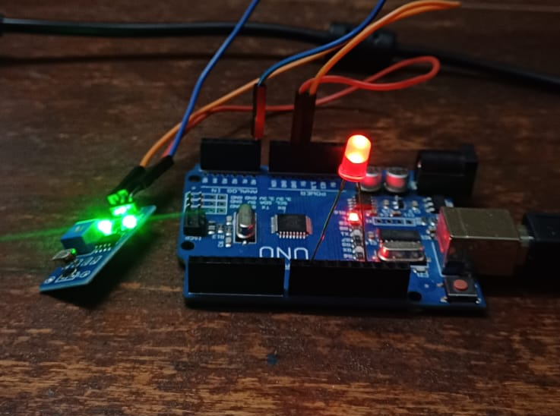
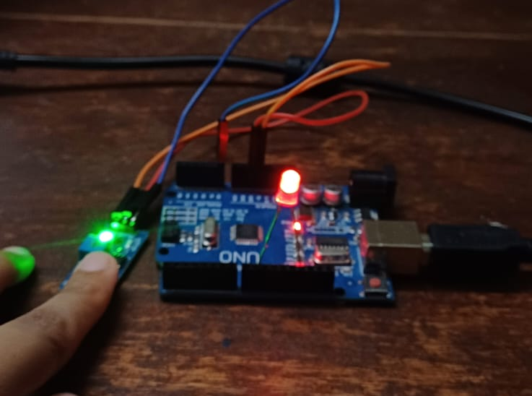
RESULTS

Slide 14
CONCLUSION
The Intelligent Street Light System offers a smart and energy-efficient solution for modern cities.
Using an LDR sensor ensures the right level of lighting while reducing energy use.
This system is more adaptable, sustainable, and efficient than traditional street lighting.

Slide 15
REFERENCES
Smart Street Lighting System Using IoT for Sustainable Urban Development Authors: P. Sharma, D. R. Kalbande
IoT-Based Smart Street Light System Authors: Sakshi Dhoke1, Sharda Jadhav, Mayuri Jasturkar
Smart Street Light Control System Using Arduino Authors: Mahendra Singh Sisodiya, Tarun Shrivastava, Ashish Patra
SMART STREET LIGHTING Using IoT Authors: T. Gopinath1, Dr. Princess maria john

Slide 16
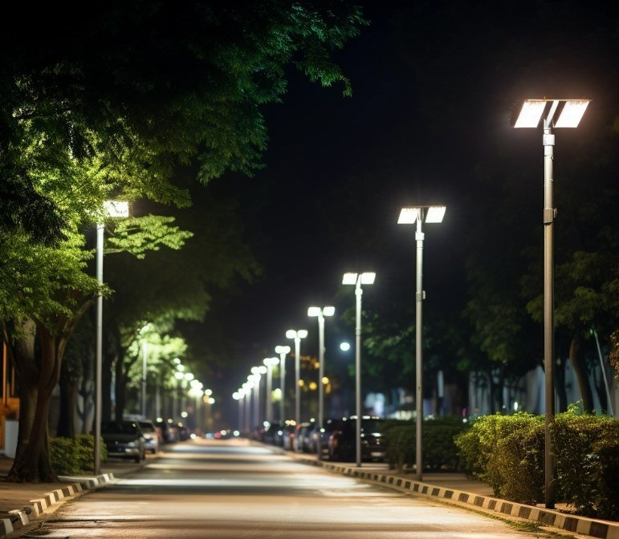
THANK YOU
Does anyone have any questions?

